Slide 1
Fuzzification
By considering quantities as uncertain:
Imprecision
Ambiguity
Vagueness
Membership Assignment
Many ways to do it!

Slide 2
Intuition
Using our intelligence and understanding.
Intuition involves contextual and semantic knowledge about an issue. It can also involve linguistic truth-values about the knowledge.
Note: they are overlapping.

Slide 3
Inference
Using knowledge to perform deductive reasoning.
Example:
Let U be a universe of triangles.
U = { (A B C) | A > B > C > 0 A + B + C = 180° }
We can define the following 5 types of triangles:
I: Approximate isosceles triangle
R: Approximate right triangle
IR: Approximate isosceles and right triangle
E: Approximate equilateral triangle
T: Other triangles

Slide 4
Inference
µ_{I}(A B C) = 1 – 1/60° min(A – B,B – C)
µ_{R}(A B C) = 1 – 1/90° |A - 90°|
IR = I ∩ R
µ_{IR}(A B C) = min [ µ_{I}(A B C), µ_{R}(A B C) ]
= 1 – max[1/60° min(A – B,B – C),1/90° |A - 90°|]
μ_{E}(A B C) = 1 – 1/180° (A – C)
T = (I ∪ R ∪ E)’ = I’ ∩ R’ ∩ E’
= min{1 - µ_{I},1 -1 µ_{R},1 - µ_{E}}
= 1/180° min{3(A – B),3(B – C),2| A - 90°|,A – C}

Slide 5
Rank Ordering
Assessing preference by a single individual, a pole, a committee, and other opinion methods can be used to assign membership values to a fuzzy variable.
Preference is determined by pair wise comparisons which determine the order of memberships.

Slide 6
Angular Fuzzy Sets
Angular Fuzzy sets are defined on a universe of angles with 2π as cycle.
The linguistic values vary with θ and their memberships are
μ_{t}(θ) = t • tan(θ)
Angular Fuzzy sets are useful for situations:
Having a natural basis in polar coordinates, or the variable is cyclic.

Slide 7
Neural Networks
We have the data sets for inputs and outputs, the relationship between I/O may be highly nonlinear or not known.
We can classify them into different fuzzy classes.
Training
Testing
R1
R2
R3
Then, the output may not only be 0 or 1!

Slide 8
Neural Networks
R1
R2
R3
0
0
0
0.2
0.7
0.1
memberships
Once the neural network is trained and tested, it can be used to find the membership of any other data points in the fuzzy classes (# of outputs)

Slide 9
Genetic Algorithms
Crossover
Mutation random selection
Reproduction
Chromosomes
Fitness Function
Stop (terminate conditions)
Converge
Reach the #limit

Slide 10
Inductive Reasoning
Deriving a general consensus from the particular (from specific to generic)
The induction is performed by the entropy minimization principle, which clusters most optimally the parameters corresponding to the output classes.
The method can be useful for complete systems where the data are abundant and static.
The intent of induction is to discover a law having objective validity and universal application.

Slide 11
Inductive Reasoning
Particular → General
Maximize entropy
Computing mean probability
Minimize entropy
The entropy is the expected value of information.
Many entropy definitions!
A survey paper

Slide 12
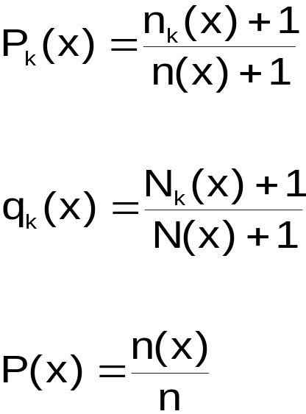
Inductive Reasoning
One example:
S(x) = p(x) S_{p}(x) + q(x) S_{q}(x)
S_{p}(x) = -[P₁(x) ln(P₁(x)) + P₂(x) ln(P₂(x))]
S_{q}(x) = -[q₁(x) ln(q₁(x)) + q₂(x) ln(q₂(x))]

Slide 13
Inductive Reasoning
Where:
n_{k}(x): # of class k samples in [x1,x1+x]
n(x): Total # of samples in [x1,x1+x]
N_{k}(x): # of class k samples in [x1+x,x2]
N(x): Total # of classes in [x1+x,x2]
n = Total # of samples in [x1,x2]
Move x in [x1,x2], and compute the entropy for each x to find the maximum / minimum entropy.
Note: there are many approaches to compute entropy.

Slide 14
Defuzzification
(Fuzzy-To-Crisp conversions)
Using fuzzy to reason, to model
Using crisp to act
Like analog → digital → analog
Defuzzification is the process: round it off to the nearest vertex.
●
Fuzzy set (collection of membership values).

Slide 15
Defuzzification
(Fuzzy-To-Crisp conversions)
A vector of values → reduce to a single scalar quantity: most typical or representative value.
Fuzzification – Analysis – Defuzzification – Action
λ-cuts for fuzzy sets
(α-cuts, some books)
A_{λ}, 0 < λ < 1
A_{λ} = {x | μ_{A}(x) > λ}
Note: A_{λ} is a crisp set derived from the original fuzzy set.
λ ∈ [0,1] can have an infinite number of values. Therefore, there can be infinite number of λ-cut sets.

Slide 16
Defuzzification
(Fuzzy-To-Crisp conversions)
Example:
A = {1/a + 0.9/b + 0.6/c + 0.3/d + 0.01/e + 0/f}
A₁ = {a} or A₁ == {1/a + 0/b + 0/c + 0/d + 0/e + 0/f}
A_{0.9} = {a,b}
A_{0.3} = {a,b,c,d}
A_{0.6} = {a,b,c}
A_{0.01} = {a,b,c,d,e}
A₀ = x = {a,b,c,d,e,f}

Slide 17
Defuzzification
(Fuzzy-To-Crisp conversions)
λ-cut re-scales the memberships to 1 or 0
The properties of λ-cut:
(A ∪ B)_{λ} = A_{λ} ∪ B_{λ}
2. (A ∩ B)_{λ} = A_{λ} ∩ B_{λ}
3. (A’)_{λ} ≠ (A_{λ})’ except for x = 0.5
4. A_{α} ⊆ A_{λ} ∀ λ < α and 0 < α < 1
A₀ = X
Core = A₁
Support = A₀⁺
Boundaries = [A₀ + A₁]

Slide 18
Defuzzification
(Fuzzy-To-Crisp conversions)
0.6
0.3
λ-cuts for fuzzy relations
1 | 0.8 | 0 | 0.1 | 0.2
0.8 | 1 | 0.4 | 0 | 0.9
0 | 0.4 | 1 | 0 | 0
0.1 | 0 | 0 | 1 | 0.5
0.2 | 0.9 | 0 | 0.5 | 1
R =

Slide 19
Defuzzification
(Fuzzy-To-Crisp conversions)
We can define λ-cut for relations similar to the one for sets
R_{λ} = {(x y) | μ_{R}(x y) > λ}
1
 | 1 |  | φ
 |  | 1
 | φ |  | 1
 |  |  |  | 1
1
 | 1 |  | φ
 |  | 1
 | φ |  | 1
 |  | 1 |  | 1
R₁ =
R_{0.9} =
R₀ = E

Slide 20
Defuzzification
(Fuzzy-To-Crisp conversions)
λ-cuts on relations have the following properties:
(R ∪ S)_{λ} = R_{λ} ∪ S_{λ}
(R ∩ S)_{λ} = R_{λ} ∩ S_{λ}
(R’)_{λ} ≠ (R_{λ})’
R_{α} < R_{λ} ∀ λ ≤ α and 0 ≤ α ≤ 1

Slide 21
Defuzzification Methods
fuzzy set → a single scalar quantity
fuzzy quantity → precise quantity
O1
O2
O = O1 ∪ O2

Slide 22
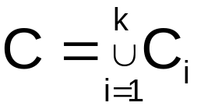
Defuzzification Methods
A fuzzy output can have many output parts
Many methods can be used for defuzzification.
They are listed in the following slides

Slide 23
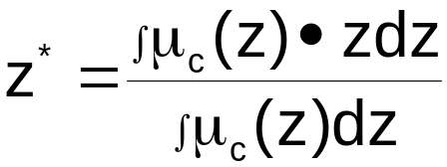
Defuzzification Methods
Max-membership principle
μ_{c}(Z*) ≥ μ_{c}(z) ∀ z ∈ Z
μ
1
z* z
Centroid principle
μ
1
z* z
Note: It relates to moments.

Slide 24
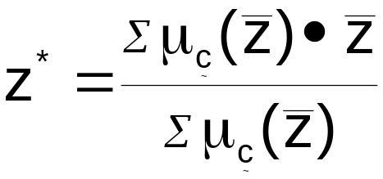

Defuzzification Methods
Weighted average method
(Only valid for symmetrical output membership functions)
μ
.9
.5
0 a b z
μ
1
Mean-max membership
(middle-of-maxima method)
0 a z* b z

Slide 25

Defuzzification Methods
Example:
A railroad company intends to lay a new rail line in a particular part of a county. The whole area through which the new line is passing must be purchased for right-of-way considerations. It is surveyed in three stretches, and the data are collected for analysis. The surveyed data for the road are given by the sets , where the sets are defined on the universe of right-of-way widths, in meters. For the railroad to purchase the land, it must have an assessment of the amount of land to be bought. The three surveys on the right-of-way width are ambiguous , however, because some of the land along the proposed railway route is already public domain and will not need to be purchased. Additionally, the original surveys are so old (circa 1860) that some ambiguity exists on the boundaries and public right-of-way for old utility lines and old roads. The three fuzzy sets , shown in the figures below, represent the uncertainty in each survey as to the membership of the right-of-way width, in meters, in privately owned land.
We now want to aggregate these three survey results to find the single most nearly representative right-of-way width (z) to allow the railroad to make its initial estimate

Slide 26
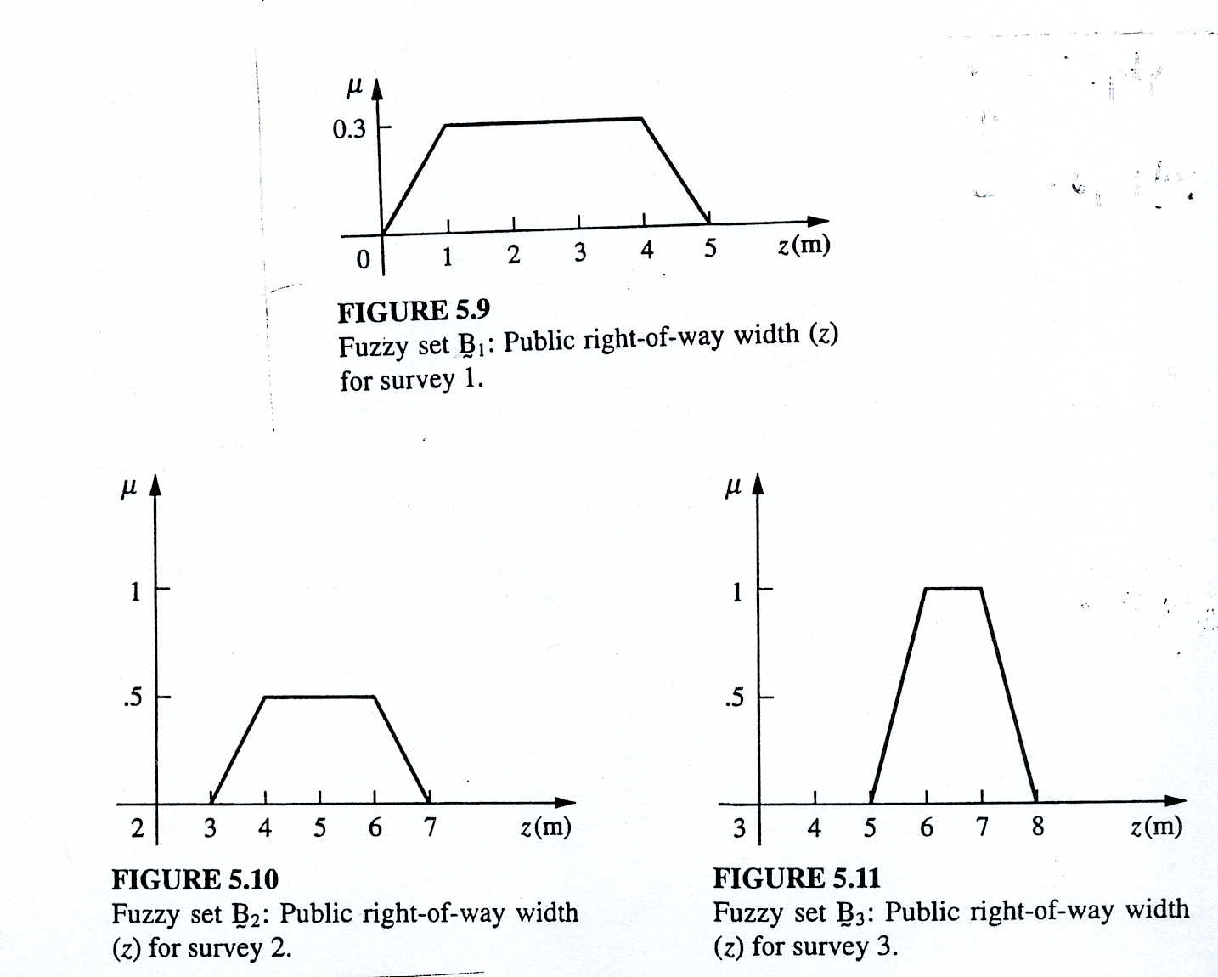
Defuzzification Methods

Slide 27
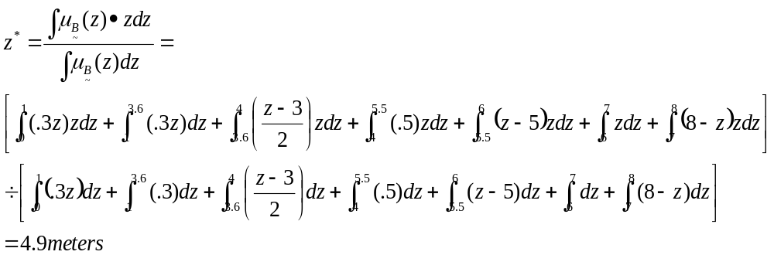
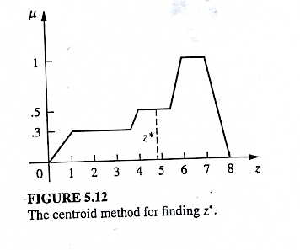
Defuzzification Methods
Centroid method:

Slide 28
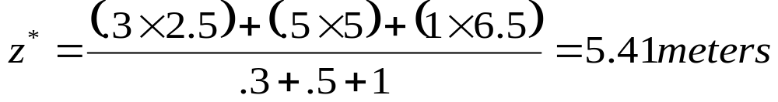

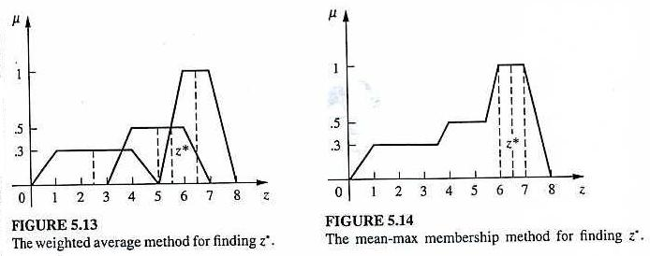
Defuzzification Methods
Weighted-Average Method:
Mean-Max Method:

Slide 29
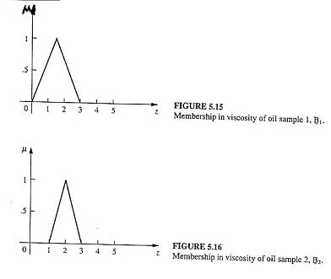
Defuzzification Methods

Slide 30
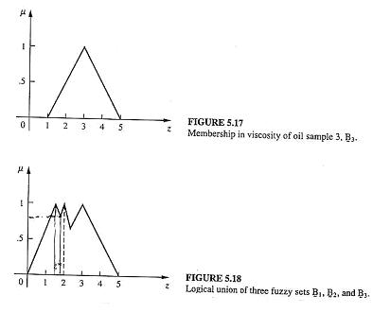
Defuzzification Methods

Slide 31
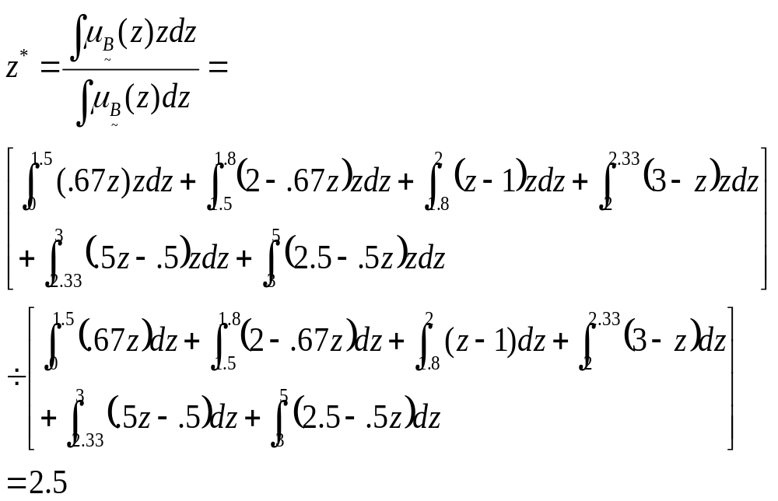
Defuzzification Methods
According to the centroid method,

Slide 32
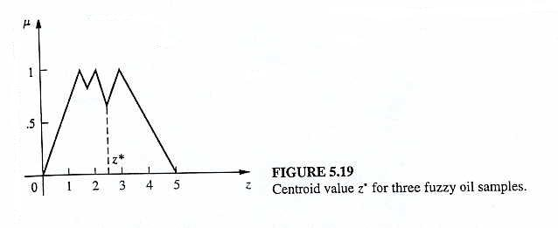
Defuzzification Methods
The centroid value obtained, z*, is shown in the figure below:

Slide 33
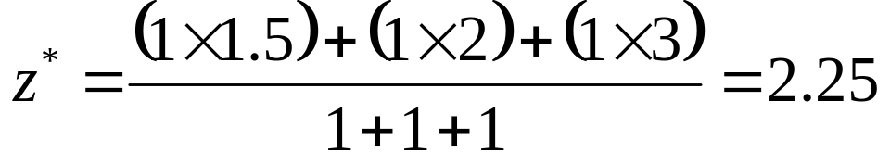
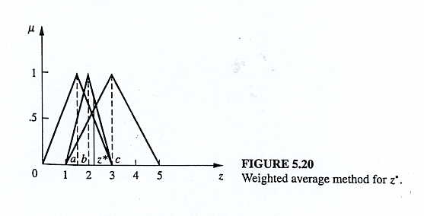
Defuzzification Methods
According to the weighted average method:

Slide 34
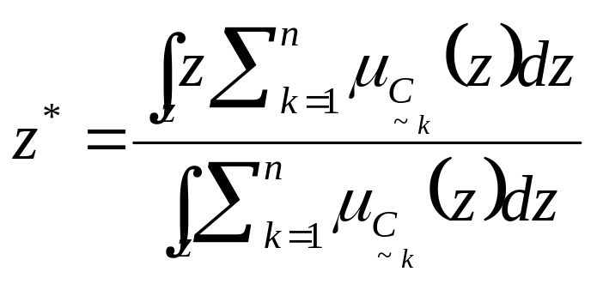
Defuzzification Methods
Center of sums Method
Faster than any defuzzification method
Involves algebraic sum of individual output fuzzy sets, instead of their union
Drawback: intersecting areas are added twice.
It is similar to the weighted average method, but the weights are the areas, instead of individual membership values.

Slide 35
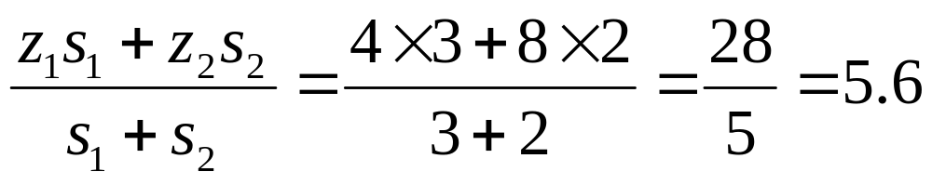
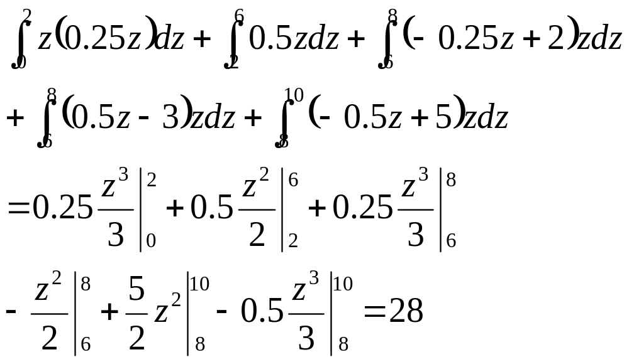
Defuzzification Methods
z₁ = 4 z₂ = 8
or

Slide 36
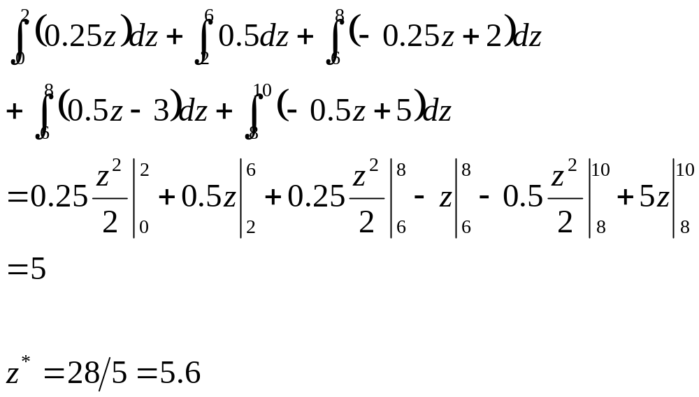
Defuzzification Methods

Slide 37
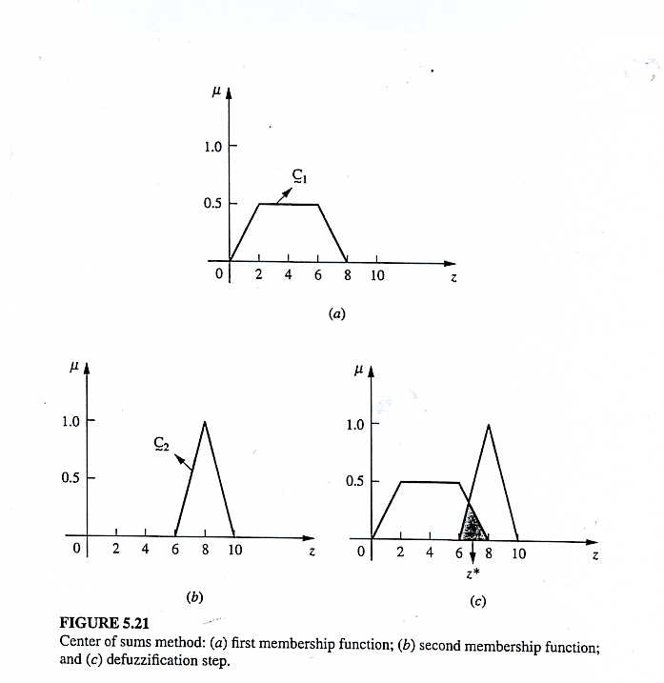
Defuzzification Methods
Center of Sums Method

Slide 38
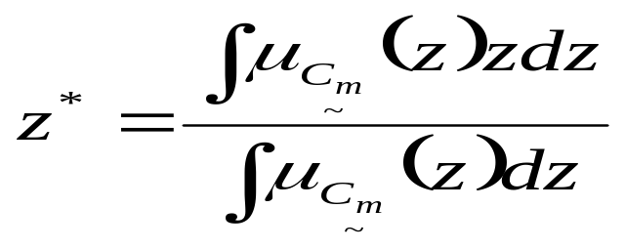
Defuzzification Methods
Using Center of sums:
S1 = 0.5 * 0.5(8+4) = 3
S2 = 0.5 * 1 * 4 = 2
Center of the largest area: if output has at least two convex sub-regions
Where C_{m} is the convex sub-region that has the largest area making up C_{k}. (see figure)

Slide 39
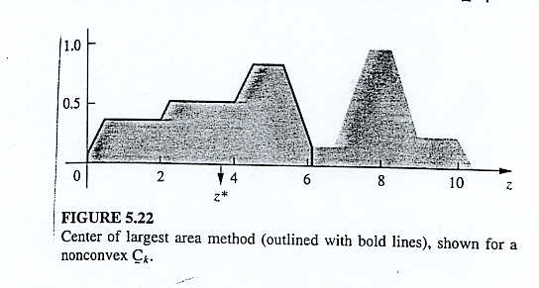
Defuzzification Methods
Center of sums method

Slide 40
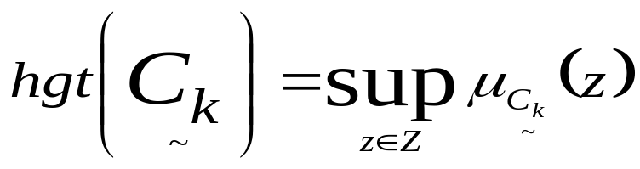
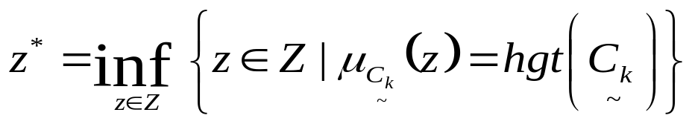
Defuzzification Methods
First (or Last) of Maxima method
This method uses the overall output or union of all individual output fuzzy sets to determine the smallest value of the domain with maximized membership degree in each output set. The equations for z* are as follows:
First, the largest height in the union is determined:
Then the first of the maxima is found:

Slide 41
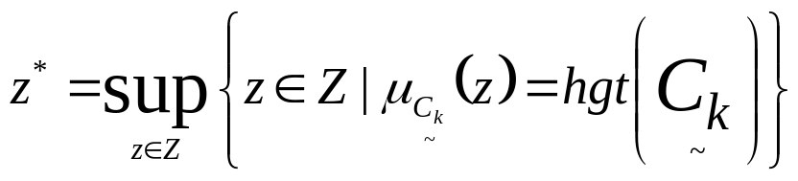
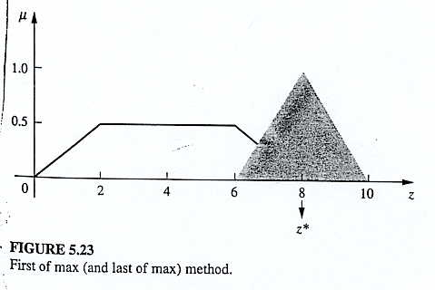
Defuzzification Methods
First (or last) of Maxima method
An alternative to this method is called the last of maxima, and it is given by:
Supremum (Sup): the least upper bound
Infimum (Inf): the greatest lower bound

Slide 42
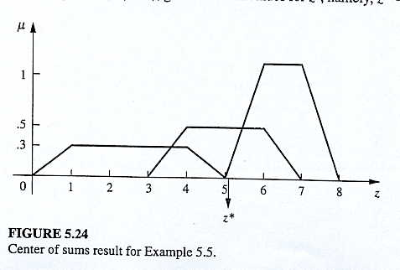
Defuzzification Methods
Continuation of the railroad example, the results of the different methods can be shown graphically as follows:

Slide 43
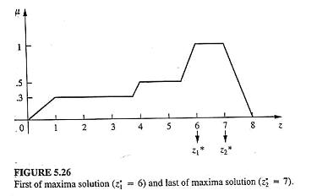
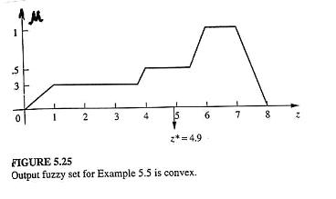
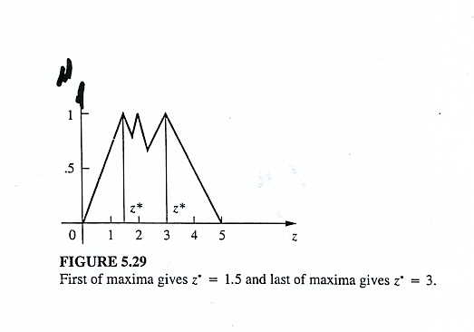
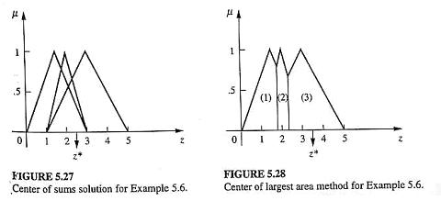
Defuzzification Methods

Slide 44
Fuzzy Arithmetic, Numbers, Vectors
The Extension Principle
x y
f(x)
How to find y if x is fuzzy, f is fuzzy or both are fuzzy

Slide 45
Crisp function, Mapping and Relation
For a set A defined on universe X, its image, set B on the universe Y is found from the mapping
B = f(A) = { y | ∀ x ∈ A, y = f(x)
B is defined by its characteristic value
X_{B}(y) = X_{f(A)}(y) = ∪ X_{A}(x)
Note: ∪ means max
y = f(x)

Slide 46
Crisp function, Mapping and Relation
Example:
A = {0/-2 +0/-1 +1/0 +1/1 +0/2}
X = {-2,-1,0,0,1,2}
If y = |4x| + 2 Y = {2,6,10}
X_{B}(2) = ∪ {X_{A}(0)} = 1
X_{B}(6) = ∪ {X_{A}(-1),X_{A}(1)} = ∪ {0,1} = 1
X_{B}(10) = ∪ {X_{A}(-2),X_{A}(2)} = ∪ {0,0} = 0
B = {1/2 + 1/6 + 0/10} or B = {2,6}

Slide 47
Crisp function, Mapping and Relation
We may consider the universe
X = {-2,-1,0,1,2} and universe Y = {0,1,2,…,9,10}
The relation describing this mapping
0 | 1 | 2 | 3 | 4 | 5 | 6 | 7 | 8 | 9 | 10
-2
-1
0
1
2
 |  |  |  |  |  |  |  |  |  | 1
 |  |  |  |  |  | 1
φ |  |  | 1 |  |  |  |  |  | φ
 |  |  |  |  |  | 1
 |  |  |  |  |  |  |  |  |  | 1
R =

Slide 48
Crisp function, Mapping and Relation
If A = {0/-2 + 0/-1 + 1/0 + 1/1 + 0/2}
Then, B = A ° R
X_{B}(y) = ∪ (X_{A}(A) ∩ X_{R}(x y))
1 for y = 2,6
=
0 otherwise
or
B = {0/0 + 0/1 + 1/2 + 0/3 + 0/4 + 0/5 + 1/6 + 0/7 + 0/8 + 0/9 + 0/10}
x ∈ X

Slide 49
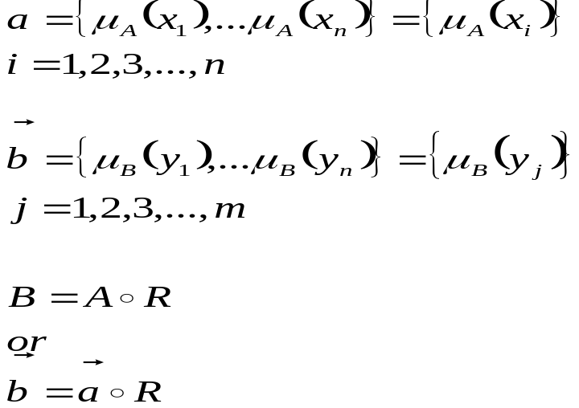
Function of Fuzzy Sets – Extension Principle
B = f(A)
If A is fuzzy, B is also fuzzy.
µ_{B}(y) = ∪ µ_{A}(x)
Fuzzy Vectors:
f(x) = y

Slide 50
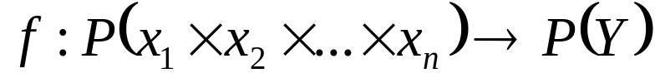
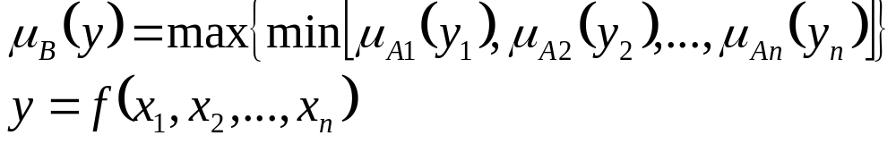
Function of Fuzzy Sets – Extension Principle
General case
Let A1,A2,…An be defined on X1,X2,…,Xn
Then B = f(A1,A2,…,An)
This is called Zadeh’s extension principle.

Slide 51
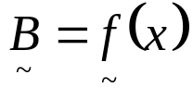
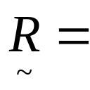
Fuzzy Transform (Mapping)
Extending fuzziness in an input set to an output set.
I: fuzzy O: fuzzy f: crisp f:A → B
If x ∈ X then is called fuzzy mapping, ~ indicates fuzzy.
It can be described as a fuzzy relation.
 | y1 | y2 | … | ym
x1 | r₁₁ | r₁₂ | … | r_{1m}
x2 | r₂₁ | r₂₂ | … | r_{2m}
: | : | : | : | :
xn | r_{n1} | r_{n2} | … | r_{nm}

Slide 52
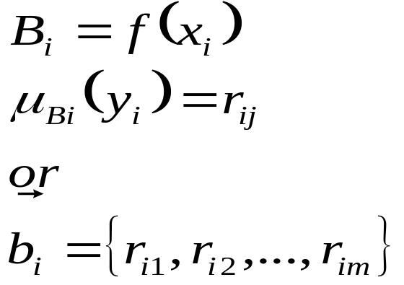
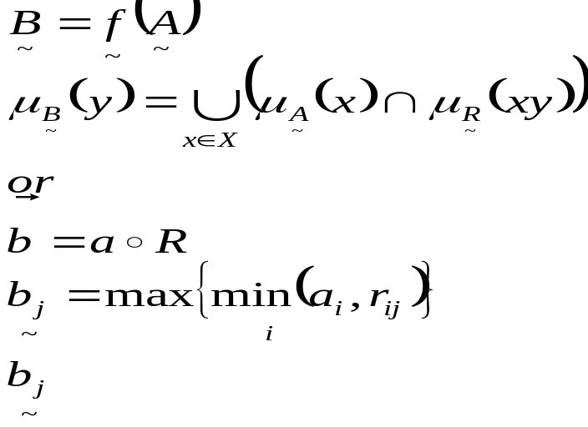
Fuzzy Transform (Mapping)
More general:
is the j^{th} element of the fuzzy image B

Slide 53
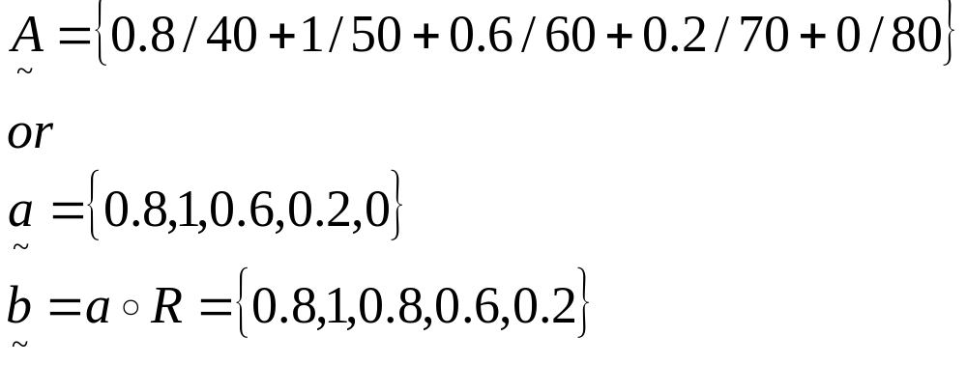
Fuzzy Transform (Mapping)
1 | 0.8 | 0.2 | 0.1 | 0 | 40
0.8 | 1 | 0.8 | 0.2 | 0.1 | 50
0.2 | 0.8 | 1 | 0.8 | 0.2 | 60
0.1 | 0.2 | 0.8 | 1 | 0.8 | 70
0 | 0.1 | 0.2 | 0.8 | 1 | 80
R =

Slide 54
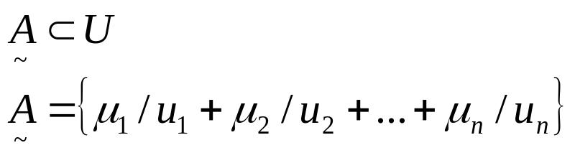
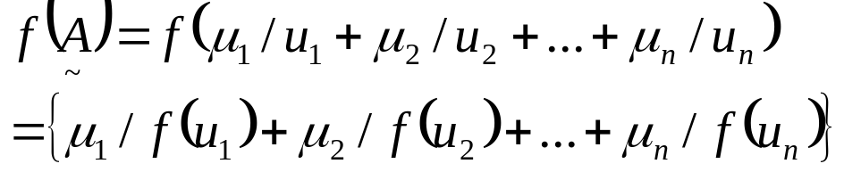
Practical Considerations
F:u → v, u ∈U and v ∈ V
Then the extension principle is
It is a mapping called one-to-one.

Slide 55
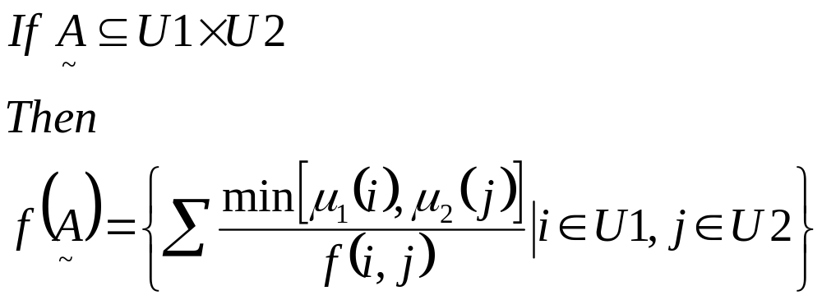
Practical Considerations
Example:
u = {1,2,3}
v= f(u) = 2u – 1
A = {0.6/1 + 1/2 + 0.8/3}
Then f(A) = {0.6/1 + 1/3 + 0.8/5}
Where µ₁(i) and µ₂(j) are the separable membership projections of µ(I,j) from U1× U2, when µ(I,j) cannot be determined.

Slide 56
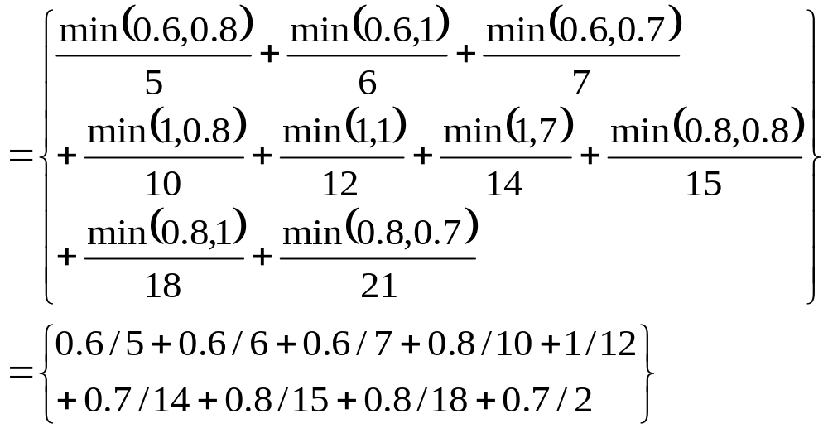
Practical Considerations
Example:
U1 = U2 = {1,2,…,10}
A = 2 = “Approximately 2” = {0.6/1 + 1/2 + 0.8/3}
B = 6 = “Approximately 6” = {0.8/5 + 1/6 + 0.7/7}
This mapping is unique. If not, we have to perform maximum operation!

Slide 57
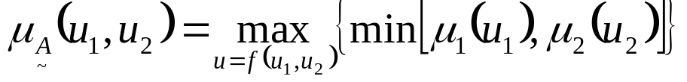
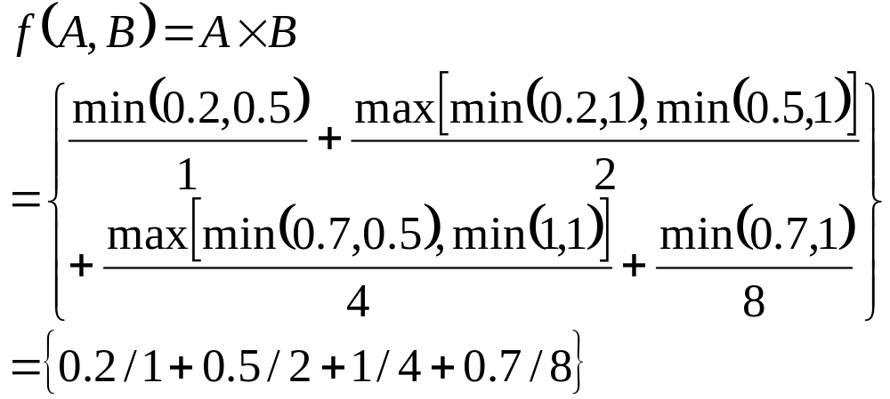
Practical Considerations
Example:
A = {0.2/1 + 1/2 + 0.7/4}
B = {0.5/1 + 1/2}

Slide 58
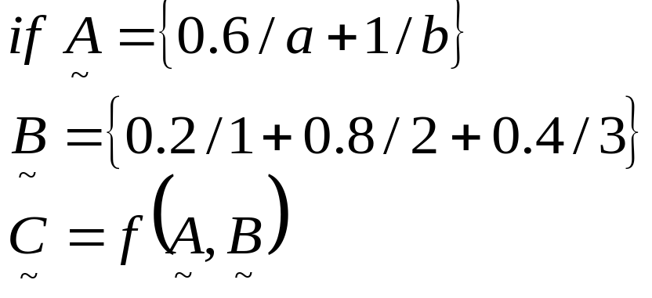
Practical Considerations
Example:
We want to map ordered pairs from the input universe X1 = {a,b} and X2 = {1,2,3} to an output universe Y={x,y,z}, for instance
 | 1 | 2 | 3
a | x | z | x
b | x | y | z
Crisp
f is described by R.

Slide 59
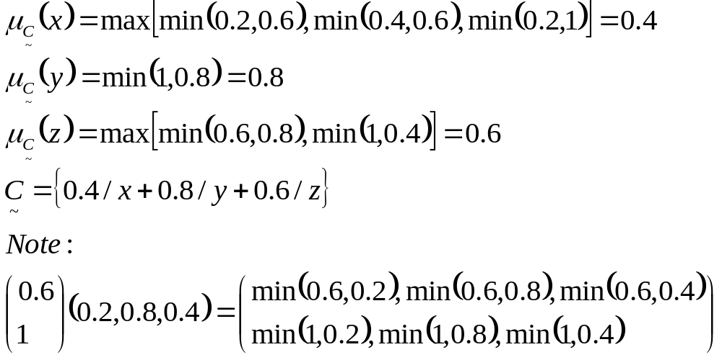
Practical Considerations

Slide 60
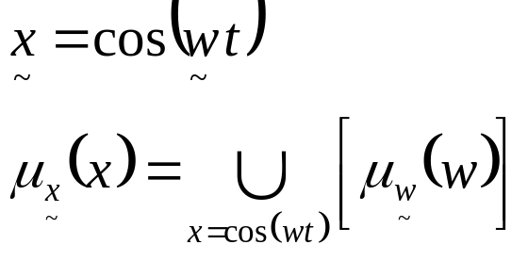

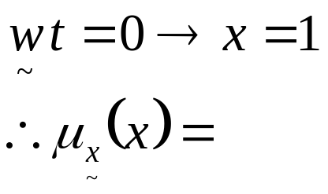
Practical Considerations
Consider:
For t = 0, all values of map into a single point.
if x = 1
0 otherwise
If t ≠ 0, but small, the supp (support of )
The membership value of in this interval is determined in a one-to-one mapping

